Slide 1
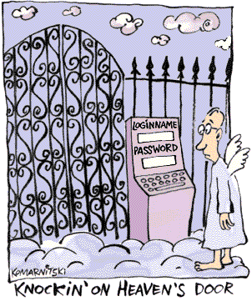
Password
Authentication
& Protection

Slide 2
Passwords
Why Are They Important?
Passwords are cheap to deploy, but also act as the first line of defense in a security arsenal.
  They are also often the weakest link.
Examples of what they protect:
  ATMs and bank accounts
  Nuclear power and other critical infrastructure systems
  Company proprietary information and systems
  Email accounts (Gmail, Hotmail, Yahoo, AOL, etc.)
  Student information (e.g. MyUalbany & WebCT)

Slide 3
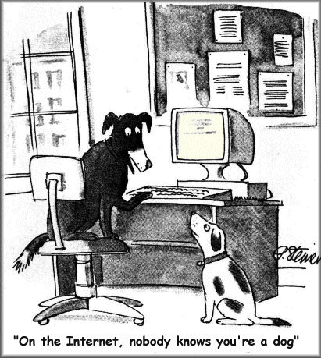
Passwords
Authentication
Passwords have been used for centuries, e.g. guards and sentries
Passwords = secret authentication code used for access.
Answers the question: How do you prove to someone that you are who you claim to be?
Authentication methods:
  What you know (Passwords, Secret keys)
  Where you are (IP Addresses)
  What you are (Biometrics)
  What you have (Secure tokens)

Slide 4
Passwords
AAA of Password Security
Authentication (& Identification)
  Establishes that the user is who they say they are (credentials).
Authorization
  The process used to decide if the authenticated person is allowed to access specific information or functions.
Access Control
  Restriction of access (includes authentication & authorization)

Slide 5
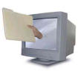

Passwords
How Can Passwords Be Stored?
Filing System
  Clear text
Dedicated Authentication Server
  Clear text
Encrypted
  Password + Encryption = bf4ee8HjaQkbw
Hashed
  Password + Hash function = aad3b435b51404eeaad3b435b51404ee
Salted Hash
  (Username + Salt + Password) + Hash function =
  e3ed2cb1f5e0162199be16b12419c012

Slide 6
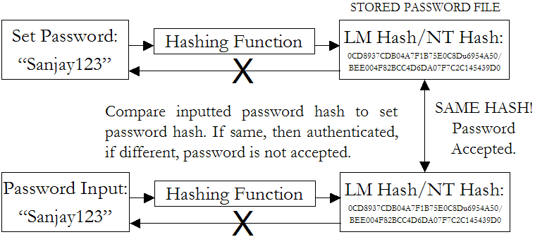
Passwords
How Are Passwords Stored? - Hashing
Usually stored as hashes (not plain text)
  Plain-text is converted into a message digest through use of a hashing algorithm (i.e. MD5, SHA)

Slide 7
Passwords
How Are Passwords Stored? - Hashing
Hash function H must have some properties:
  One-way: given H(password), hard to find password
    No known algorithm better than trial and error
  Collision-resistant: given H(password1), hard to find password2 such that: H(password1) = H(password2)
    It should even be hard to find any pair p1,p2 s.t. H(p1)=H(p2)

Slide 8
Passwords
How Are Passwords Stored? – Early UNIX Systems
In past UNIX systems, password used modified DES (encryption algorithm) as if it were a hash function
  Encrypts NULL string using password as the key (truncates passwords to 8 characters!)
  Caused artificial slowdown: ran DES 25 times
Also stored password file in directory: /etc/passwd/
  World-readable (anyone who accessed the machine would be able to copy the password file to crack at their leisure)
  Contained userIDs/groupIDs used by many system programs
  Can instruct modern UNIXes to use MD5 hash function

Slide 9
Passwords
Plain Text Security Issues
System administrator at MIT was editing the password file and another was editing the daily message (appeared on everyone’s login terminal). Due to a software error, the editor files were switched and the password file was printed every time someone logged in.
- Robert Morris & Ken Thompson (April 3, 1978)

Slide 10

Passwords
How Are Passwords Stored? - Newer UNIX Systems
Password hashes stored in /etc/shadow directory (or similar)
  only readable by system administrator (root)
Less sensitive information still in /etc/password
Added expiration dates for passwords
Early “shadow” implementations on Linux called the login program which had a buffer overflow!

Slide 11
Passwords
How Are Passwords Stored? – Windows NT/2k/XP/Vista
Uses 2 functions for “hashing” passwords:
  LAN Manager hash (LM hash)
    Password is padded with zeros until there are 14 characters.
    It is then converted to uppercase and split into two 7-character pieces
    Each half is encrypted using an 8-byte DES (data encryption standard) key
    Result is combined into a 16-byte, one way hash value
  NT hash (NT hash)
    Converts password to Unicode and uses MD4 hash algorithm to obtain a 16-byte value
Hashes stored in Security Accounts Manager (SAM)
  Locked within system kernel when system is running.
  Location - C:\WINNT\SYSTEM32\CONFIG
SYSKEY
  Utility which moves the encryption key for the SAM database off of the computer

Slide 12
Passwords
Impact on Security
Simple hacking tools are available to anyone who looks for them on the Internet.
Tools such as LOphtCrack allow admittance into almost anyone's account if a simple eight-digit password is used.
People are frightened when they learn that using only an eight-digit password with standard numbers and letters will allow anyone to figure out their passwords in less than two minutes when one downloads a publicly available tool like LOphtCrack from the Internet. This was the kind of tool which we found
(in Al Qaeda’s arsenal), nothing terribly sophisticated.
- Richard Clark, Presidents Advisor on Cyber Security (2001-2003)
Sometimes even hacking tools aren’t even necessary

Slide 13
Passwords
Threats to Password Security, Part 1
Disclosure
  Voluntary disclosure of information
  Inadequate guarding of system passwords
Inference
  Known pattern to creation of passwords
  Use of generated passwords with predictable algorithm
Exposure
  Accidental release of password
Loss
  Forgetting to remember passwords
  Can lead to creation of easy passwords

Slide 14
Passwords
Threats to Password Security, Part 2
Snooping/Eavesdropping
  Keyloggers
  Network sniffing (intercepting of network communication where a password is submitted)
Guessing
  Limited amount of choices which can be figured out through process of elimination
  Use of blank/common passwords, passwords which can be figured out by knowing name of relatives, pets, etc.
Cracking
  Automated “guessing”

Slide 15
Passwords
Why Cracking is Possible
Passwords are NOT truly random
  52 upper/lowercase letters, 10 digits, and 32 punctuation symbols equals ≈ 6 quadrillion possible 8-character passwords
  People like to use dictionary words, relative and pet names equaling ≈ 1 million common passwords
  On average, each person has 8-12 passwords:
  Different systems impose different password requirements.
  Passwords need to be changed often.
  Some passwords are only used occasionally.

Slide 16
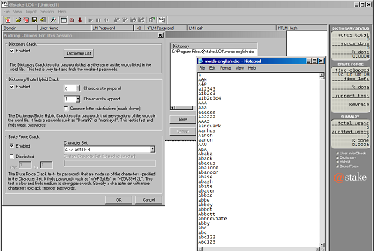
Passwords
Dictionary Attack
Attacker can compute H(word) for every word in a dictionary and see if the result is in the password file
With 1,000,000-word dictionary and assuming 10 guesses per second, brute-force online attack takes 50,000 seconds (14 hours) on average
  This is very conservative; Offline attack is much faster!

Slide 17
Passwords
Types of Password Cracking
Dictionary Attack
  Quick technique that tries every word in a specific dictionary
Hybrid Attack
  Adds numbers or symbols to the end of a word
Brute Force Attack
  Tries all combinations of letters, numbers & symbols
Popular programs for Windows password cracking
  LophtCrack (discontinued by Symantec when acquired @stake)
  Cain & Abel (UNIX)
  John the Ripper (UNIX)
  Sam Inside

Slide 18
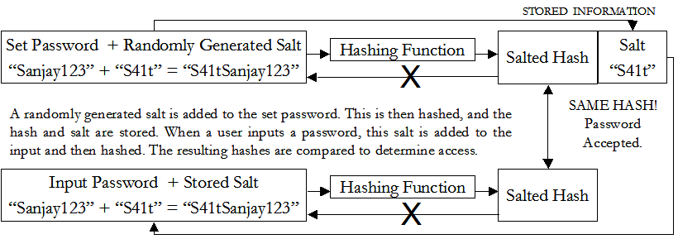
Passwords
Cracking Protection - Salting
Salting requires adding a random piece of data and to the password before hashing it.
  This means that the same string will hash to different values at different times
  Users with same password have different entries in the password file
  Salt is stored with the other data as a complete hash
Hacker has to get the salt add it to each possible word and then rehash the data prior to comparing with the stored password.

Slide 19
Passwords
Cracking Protection - Salting Advantages
Without salt, attacker can precompute hashes of all dictionary words once for all password entries
  Same hash function on all UNIX machines
  Identical passwords hash to identical values; one table of hash values can be used for all password files
With salt, attacker must compute hashes of all dictionary words once for each password entry
  With 12-bit random salt, same password can hash to 212 different hash values
  Attacker must try all dictionary words for each salt value in the password file

Slide 20
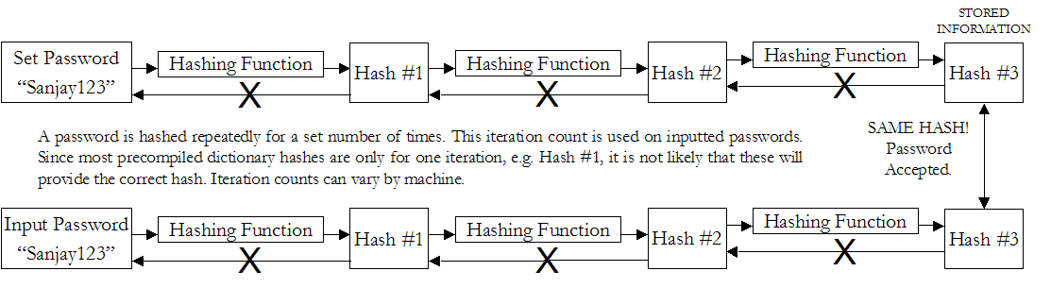
Passwords
Cracking Protection - Iteration Count
The same password can be rehashed many times over to make it more difficult for the hacker to crack the password.
This means that the precompiled dictionary hashes are not useful since the iteration count is different for different systems
  Dictionary attack is still possible!

Slide 21
Passwords
Authentication Protocols
TIME STAMP
  The authentication from the client to server must have time-stamp embedded
  Server checks if the time is reasonable
  Protects against replay
  Depends on synchronization of clocks on computers
ONE-TIME PASSWORD
  New password obtained by passing user-password through one-way function n times which keeps incrementing
  Protects against replay as well as eavesdropping
TRANSFORMED PASSWORD
  Password transformed using one way function before transmission
  Prevents eavesdropping but not replay
CHALLENGE-RESPONSE
  Server sends a random value (challenge) to the client along with the authentication request. This must be included in the response
  Protects against replay

Slide 22
Passwords
Challenge Response
User and system share a secret key
Challenge: system presents user with some string
Response: user computes response based on secret key and challenge
  Secrecy: difficult to recover key from response
    One-way hashing or symmetric encryption work well
  Freshness: if challenge is fresh and unpredictable, attacker on the network cannot replay an old response
    For example, use a fresh random number for each challenge
Good for systems with pre-installed secret keys
  Car keys; military friend-or-foe identification

Slide 23
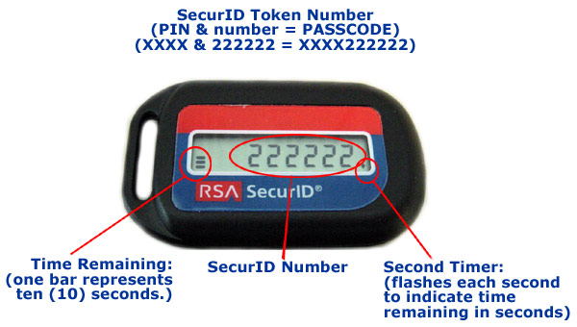
Passwords
Personal Token Authentication
Personal Tokens are hardware devices that generate unique strings that are usually used in conjunction with passwords for authentication
A variety of different physical forms of tokens exist
  e.g. hand-held devices, Smart Cards, PCMCIA cards, USB tokens
Different types of tokens exist:
  Storage Token: A secret value that is stored on a token and is available after the token has been unlocked using a PIN
  Synchronous One-time Password Generator: Generate a new password periodically (e.g. each minute) based on time and a secret code stored in the token
  Challenge-response: Token computes a number based on a challenge value sent by the server
  Digital Signature Token: Contains the digital signature private key and computes a computes a digital signature on a supplied data value

Slide 24
Passwords
Improving Security
Password complexity
  Case-sensitivity
  Use of special characters, numbers, and both upper and lower-case letters
  Minimum length requirements
Security questions
  Ask personal questions which need to be verified
  Some questions are very easy to discover answers
Virtual keyboard
  Person clicks on-screen keyboard to enter
  password (prevents keylogging)
Single sign-on
  User only has to remember one password at a time and yet can access all/most of their resources
  AKA Enterprise Reduced Sign-On (almost impossible to have one password used for everything due to integration issues)
Centralized password storage management
  Online sites accessible through one password which contain all other passwords
Single point
of failure, but
easier to
remember

Slide 25
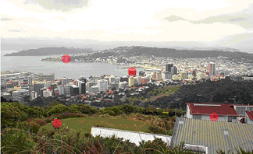
Passwords
Improving Security
Graphical passwords
  Goal: increase the size of memorable password space
Rely on the difficulty of computer vision
  Face recognition is easy for humans, harder for machines
  Present user with a sequence of faces, he must pick the right face several times in a row to log in
Other examples
  Click on a series of pictures in order
  Drawing a picture
  Clicking four correct points on a picture
Reading graphical text
  Requires user to input text based on what is seen in the graphic. Attempts to curb automated password crackers due to difficulty in distinguishing letters/numbers
  Scheme where users had to input text based on graphics shown to “undress” a picture

Slide 26
Passwords
Biometric/Behaviometric Authentication
Uses certain biological or behavioral characteristics for authentication
  Biometric reader measures physiological indicia and compares them to specified values
  It is not capable of securing information over the network
Biological Examples
  Fingerprint, Iris, Retina, Face, & Hand Recognition
Behavioral Examples
  Handwriting, Gait, Typing Rhythm, Mouse Gesture Recognition

Slide 27
Passwords
Biometric Considerations
Universality | How commonly biometric is found
Uniqueness | How well biometric distinguishes between others
Permanence | How well biometric resists aging
Collectability | How easy biometric is to acquire
Performance | Accuracy, speed, and robustness of system capturing biometric
Acceptability | Degree of approval by the public for use
Circumvention | How hard it is to fool authentication system

Slide 28
Passwords
Protection/Detection
Protection:
  Disable storage of LAN Manager hashes.
  Configure both Local and Domain Account Policies (Password & Account Lockout Policies).
  Audit access to important files.
  Implement SYSKEY security on all systems.
  Set BIOS to boot first from the hard drive.
  Password-protect the BIOS.
  Enforce strong passwords!
  Change your passwords frequently.
  Use two or three factor authentication.
  Use one time passwords.

Slide 29
Passwords
Ten Common Mistakes
Leaving passwords blank or unchanged from default value.
Using the letters p-a-s-s-w-o-r-d as the password.
Using a favorite movie star name as the password.
Using a spouse’s name as the password.
Using the same password for everything.
Writing passwords on post-it notes.
Pasting a list of passwords under the keyboard.
Storing all passwords in an Excel spreadsheet on a PDA or inserting passwords into a rolodex.
Writing all passwords in a personal diary/notebook.
Giving the password to someone who claims to be the system administrator.

